Slide 1
DLF ALOHA

Slide 2
GOALS
Understanding & Communicating Functional Requirements for Digital Libraries
Business requirements ←→ business services (what are they, what should we keep, which are automatable)
Abstract services needed for interoperability (share software & services)
At the service binding level, there are OKI-esque apis, protocols, user interfaces (ala portlets) w/or w/out associated data models
Some overlap between these types of service definition (many to many relationship)… future library is in the overlap + new stuff
Need to understanding what is “core” to the library and what can be outsourced.
Digital archiving & digital publishing are possible NEW lines of business, while some old lines of business may be outsourced (e.g. by Google).
Libraries are fragmented, disorganized, leaders don’t yet understand the nature of the data needed to support D2D, what business libraries will be in. Need to define the libraries “value-add”.
Business Entities need to be enumerated and defined (e.g. ERMI)
Verbs: services and processes (e.g. search, migrate, etc.) need to be enumerated and defined (these will be the names of the abstract services, and the purpose is to avoid unnecessary duplication of services). Business Functions (e.g. discover, preserve) will be consumers of abstract services.
Business Processes <- model -> Business Functions <- enumerate/factor -> Abstract Services <- define -> Services

Slide 3
Business
Requirement
Business
Requirement
Business
Process
Business
Process
Business
Process
…
Abstract
Service
Abstract
Service
…
Abstract
Service
Abstract
Service
…
Abstract
Service
Abstract
Service
…
Service
Service
Service
Service
Service
Service
…
…
…
Business Requirement Profile (a “slice” of the Digital Library Abstract Service Framework)
A fuller picture would also show common services, etc

Slide 4
Long-Term
Preservation
Ingest
Data
Management
Archival
Store
Preservation
Planning
Access
Administration
Receive
Submission
Administer
Database
Receive
Data
Monitor
Designated
Community
Coordinate
Access
Activities
Negotiate
Submission
Agreement
Quality
Assurance
Perform
Queries
Manage
Storage
Hierarchy
Monitor
Technology
Generate
DIP
Manage
System
Config.
Generate
AIP
Generate
Report
Replace
Media
Develop
Preservation
Strategy
Deliver
Response
Archival
Information
Update
Extract
Metadata
Receive
Database
Updates
Error
Checking
Packaging,
Migration
Planning
Physical
Access
Control
Coordinate
Updates
Disaster
Recovery
Establish
Standards,
Policies
Provide
Data
Audit
Submission
Activate
Requests
Business Requirement
Example: OAIS Reference Model
Business Process
Customer
Service
Abstract Service

Slide 5
JISC IE
D2D
Enter
Survey
Discover
Detail
Request
Deliver
Authentic-
ation
Service
Registry
Search
Identifier
Authorisation
User
Preferences
Terminology
Federated
Search
Rating/
Annotation
Alert
Resolver
Terminology
DRM
Metadata
Schema
Registry
Authorisation
Harvesting
Authorisation
Business Requirement
Business Process
Abstract Service

Slide 6
Digital Collection Management
Collection Building
Collection Maintenance
Collection Destruction
Set Policy
Inventory
Set Policy
Inventory
Inventory
Target Discovery
Selection
Access control
Reporting
Access control
Access control
Target Selection
Source Discovery
Describe
Selection
Describe
Describe
Target Transaction
Source Selection
Contextualize
Source Discovery
Contextualize
Contextualize
Send
Source Transaction
Register
Source Selection
Register
Register
Destroy
Receive
Source Transaction
Target Discovery
Receive
Target Selection
Preserve
Target Transaction
Business Requirement
Send
Business Process
Abstract Service

Slide 7
Intelligences (Community Knowledge)
  Content types, e.g. media, genres, formats
  Content sources (e.g. publishers, donors, government agencies, institutions, digitized collections) and relationships with them
  Subject areas, content magnitude
  User base
  Financial resources, marketplace
  Mission, goals
  Gaps (existing collection, collection goals)
  Drag of history

Slide 8
Scoping Services
Set Policy
  Depends on Community Knowledge
  Sets collection goals and constraints
Selection
  Survey/Discover (current environment)
  [re]Appraisal to support get/keep/weed decisions
  Policy application
  Identify funding (resource development?)
Reporting
  Internal (e.g. usage statistics, collection statistics)
  External (e.g. financial markets, other libraries, subject evolution, vendor businesses)
  Supports community knowledge for [re]selection

Slide 9
Purchase Decision Chain Services
Source discovery
  Identify possible sources of selected material
Source selection
  Evaluate possible sources
  Experiment/pilot providers
Source transaction
  Negotiation with selected source, e.g. price, terms and conditions
  Ordering process
  Ownership transfer agreement

Slide 10
Transfer Services
Receive
  Moving or gaining access to material
  Transfer of ownership
Send
  Sending material to target repository
  Transfer of ownership

Slide 11
Accession Services – Intellectual Control
Can be done per item, or across collections via batch metadata creation, updates
Can be reversed to support “deaccession” and reapplied to support “re-accession”
Describe
  Absolute properties of collection items, e.g. physical characteristics
  Identification, technical metadata
Contextualize
  Semantic metadata assignment
  Name authority control, subject classification
  Version control
  Rights and usage information
Register
  Internal (e.g. alert services)
  External (e.g. OCLC holdings)
  Active or passive

Slide 12
Accession Services – Physical Control
Can be done per item, or across collections via batch metadata creation, updates
Can be reversed to support “deaccession” and reapplied to support “re-accession”
Inventory
  Piece-level location, identification (e.g. shelf-list)
  Systems administration (e.g. backup/recovery; environmental control; hardware selection, monitoring, capacity planning)
  Collection integrity monitoring (e.g. checksum verification)
Access control
  Systems administration (e.g. server security, network security)
  Authentication/authorization
  Proxy servers
  Terms & Conditions enforcement

Slide 13
Conservation Services
Non-reversible
Preserve
  Physical processing for ongoing accessibility (e.g. format migration, renderer emulation)
  Includes activities like monitoring for digital format obsolescence (e.g. via the GDFR)
Destroy
  Permanent, auditable removal from physical existence

Slide 14
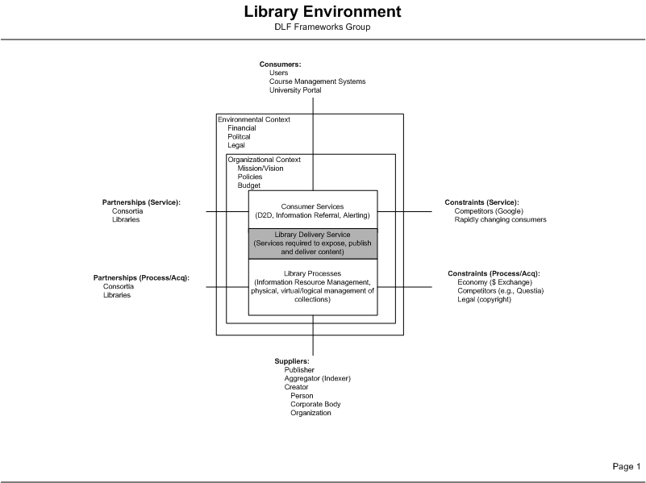

Slide 15
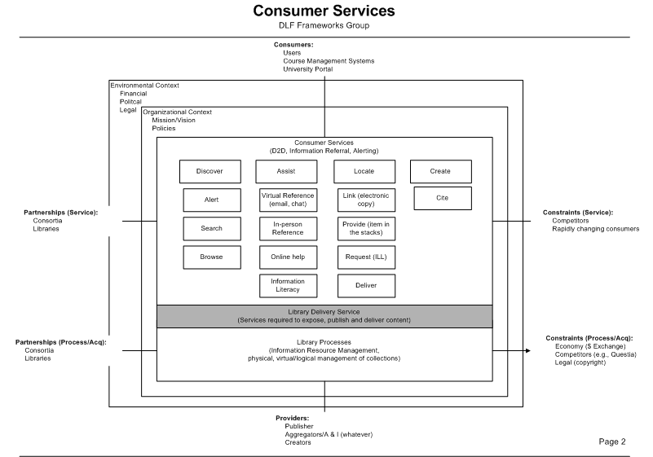

Slide 16
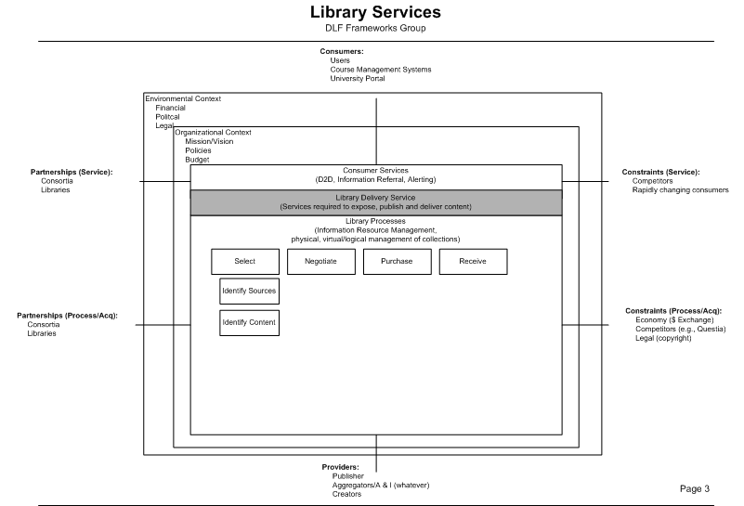

Slide 17
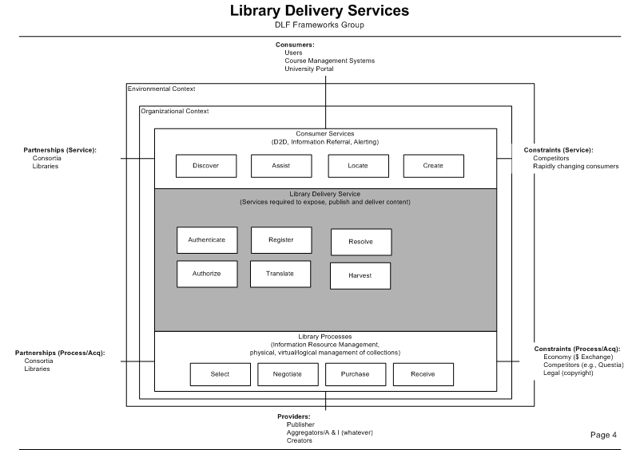

Slide 18
ENTITIES
that take action, or upon whom actions are taken …
Resource: object of interest (e.g., content, metadata, services)
Service: functionality available over a network
Consumer: person or service that consumes (utilizes) a resource
Supplier: entity that supplies (provides) a resource

Slide 19
VERBS
Alert: notify consumers about new or updated resources.
Authenticate: establish the identity of a consumer.
Authorize: determine and indicate whether a consumer has the necessary permissions to carry out a particular action.
Browse: support unstructured navigation through a resource collection.
Deliver: transfer a resource (or copy of a resource) from a supplier to a consumer.
Describe: provide information about a resource to support its use by consumers (e.g., create metadata).
Disclose: make resources available for consumption through one or more services.
Discover: identify resources relevant to the needs of a consumer.
Harvest: collect resources.
Register: actions taken by a supplier of a resource to notify services of the existence of the resource (e.g., a user profile registry, a metadata schema registry, a service registry, etc.).
Request: manage and respond to pre-defined steps by which a consumer indicates a wish to obtain a resource.
Resolve: accept a resource identifier and return locations of instances of the resource (e.g., a URL).
Search: accept a structured query and issue a set of results in response to the query.
Transform: translate one resource into another resource.

Slide 20
VERB STRINGS
String:
Describe – Register – Disclose – Search – Discover – Resolve – Request – Authenticate – Authorize
Story:
Supplier of a service creates information about the service (DESCRIBE) to populate a service registry (REGISTER), which in turn is made available to other services (DISCLOSE). Consumers accessing the registry use this information to evaluate the services listed in the registry (SEARCH) and determine that a particular service is useful for their needs (DISCOVER). Once a relevant service is identified, the consumer obtains information on where it is located (RESOLVE), and upon reaching that location, enters into the procedures necessary to access and use the service (REQUEST, AUTHENTICATE, AUTHORIZE).

